Slide 1
Improving Simulation Model Calibration for Cost-Effectiveness Analysis via Bayesian Methods
Progress Report 2023

Slide 2
background
Research objectives
State of the art
Research Methodology
Work plan
Detailed work for current course
PRELIMINARY RESULTS
Publications
Conclusions

Slide 3
COST-EFFECTIVENESS ANALYSIS
Cost-Effectiveness Analyses are a type of economic evaluation that COMPARE the health COSTS and BENEFITS of different health interventions (e.g. cancer diagnosis, screening, treatment, …).
The objective is to MAXIMIZE the health benefits of the population while MINIMIZING the costs or ESTABLISHING a certain cost.
SIMULATION
MODEL
HEALTH AND ECONOMIC OUTPUTS
COST-EFFECTIVENESS ANALYSIS
ASSIST IN DECISION-MAKING
To test or not to test?
To screen or not to screen?
Which is the optimal treatment, test or screening strategy?
…
INTERVENTIONS
They can help decision-making and allocate resources in complex and uncertain situations.

Slide 4



SIMULATION MODELS IN HEALTHCARE
A mathematical simulation model tries to reproduce/imitate the dynamics of a disease over time.
Example: Simulation of the natural history of lung cancer
NORMAL LUNG
LUNG CANCER
I-II
LUNG CANCER
IIIa
LUNG CANCER
IIIB-IV
TIME
…and different interventions
SMOKING CESSATION
¿counseling?
¿drugs?
SCREENING
…
¿gender?

Slide 5
SIMULATION MODELS IN HEALTHCARE
The purpose is to understand the dynamics of the disease and to implement and evaluate new or existing strategies (screening, diagnosis, treatment, …) to change these dynamics.
Example: Simulation of the natural history of lung cancer
We know that both preventive interventions are effective, but we want to know which one is the best combination of both for our population (parameters?).
Type (counseling or drugs)
Ages
Frequency
Gender
…
Age range
Frequency
…
5

Slide 6
SIMULATION MODELS IN HEALTHCARE
These models use empirical evidence as a starting point to project the medium and long-term impact of the interventions or the interactions between them.
Example: Simulation of the natural history of lung cancer
Example: Simulation of the natural history of lung cancer
NORMAL LUNG
LUNG CANCER
I-II
LUNG CANCER
IIIa
LUNG CANCER
IIIB-IV
TIME
…and different interventions
SMOKING CESSATION
¿counseling?
¿drugs?
HEALTH & ECONOMIC IMPACT
SCREENING
…
¿gender?

Slide 7
SIMULATION MODELS IN HEALTHCARE
Parameters based on literature review and expert consensus:
NATURAL HISTORY OF DISEASE:
Epidemiology
Risk of disease
Survival
Risk factors
Diagnosis cost
Treatment costs …
INPUTS
Probabilities of developing the disease
Probabilities of death
Probability of progress
Probability of disease recurrence …
OUTPUTS (annual, total)
Average life expectancy
Average life expectancy adjusted by quality of life
Average cost per person
Incidence rates
Mortality rates …
SIMULATION
MODEL
INTERVENTIONS
Diagnostic efficacy
Sensitivities of the tests
Specificities of the tests
Therapeutic efficacy
Cost of tests …

Slide 8
CALIBRATION
Parameters for these simulations are obtained from scientific literature, clinical studies, …
Uncertainty in the simulation results
We may have knowledge about the outcomes for the natural history.
We can reduce uncertainty in some parameters by changing their values so the simulated and expected outputs for the natural history are as similar as possible (calibration).
The calibrated parameters reduce the uncertainty when simulating the rest of strategies.

Slide 9
CALIBRATION
Parameters for these simulations are obtained from scientific literature, clinical studies, …
Uncertainty in the simulation results
We need a procedure to reduce uncertainty in these parameters by using knowledge about the natural history (calibration).
The calibrated parameters reduce the uncertainty when simulating the rest of strategies.

Slide 10
CALIBRATION
NATURAL HISTORY
INPUTS
OUTPUTS
STRATEGY 1
INPUTS
OUTPUTS
STRATEGY 2
INPUTS
OUTPUTS
. . .

Slide 11

CALIBRATION
NATURAL HISTORY
REAL-WORLD DATA
Incidence rates
Mortality rates
$$≈$$
INPUTS
OUTPUTS
STRATEGY 1
INPUTS
OUTPUTS
STRATEGY 2
INPUTS
OUTPUTS
. . .

Slide 12
CALIBRATION
NATURAL HISTORY
REAL-WORLD DATA
Incidence rates
Mortality rates
CALIBRATED INPUTS
$$≈$$
OUTPUTS
STRATEGY 1
INPUTS
OUTPUTS
STRATEGY 2
INPUTS
OUTPUTS
. . .

Slide 13
CALIBRATION
NATURAL HISTORY
REAL-WORLD DATA
Incidence rates
Mortality rates
CALIBRATED INPUTS
$$≈$$
OUTPUTS
STRATEGY 1
INPUTS
OUTPUTS
MORE RELIABLE ANALYSIS
STRATEGY 2
INPUTS
OUTPUTS
. . .

Slide 14
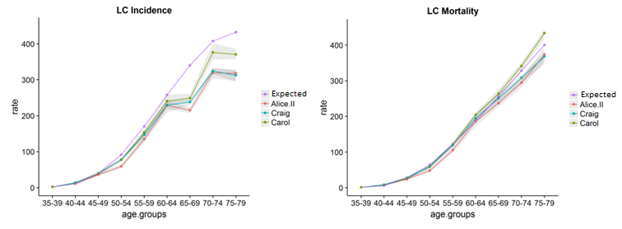
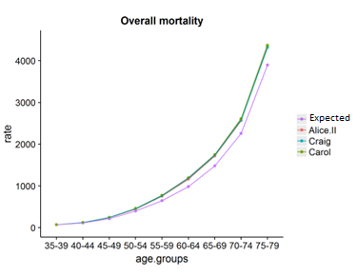
CALIBRATION
Example: Calibration of LC incidence and mortality, and overall mortality

Slide 15
CALIBRATION
Model calibration is an optimization problem of a function with some particularities:
We know the logic between inputs and outputs
Can be computationally expensive
Can be high-dimensional
Can be highly-constrained
Traditional methods used (Nelder-Mead, Simulated Annealing, ...) would require a lot of simulations and can take a long time, with no guarantee of finding valid solutions.
A more efficient approach to calibrate these simulation models is possible by incorporating our domain knowledge about these models.

Slide 16
CALIBRATION
Before simulating the interventions we wish to evaluate, we must perform calibration on the natural history:
NATURAL HISTORY OF DISEASE:
Epidemiology
Risk of disease
Survival
Risk factors
Diagnosis cost
Treatment costs
…
INPUTS by age
Probabilities of developing the disease
Probabilities of death
Probability of progress
Probability of disease recurrence
…
OUTPUTS (annual, total)
Average life expectancy
Average life expectancy adjusted by quality of life
Average cost per person
Incidence rates
Mortality rates
…
SIMULATION
MODEL OF NATURAL HISTORY

Slide 17

CALIBRATION
Before simulating the interventions we wish to evaluate, we must perform calibration on the natural history.:
NATURAL HISTORY OF DISEASE:
Epidemiology
Risk of disease
Survival
Risk factors
Diagnosis cost
Treatment costs
…
INPUTS by age
Probabilities of developing the disease
Probabilities of death
Probability of progress
Probability of disease recurrence
…
OUTPUTS (annual, total)
Average life expectancy
Average life expectancy adjusted by quality of life
Average cost per person
Incidence rates
Mortality rates
…
SIMULATION
MODEL OF NATURAL HISTORY
$$≈$$
REAL-WORLD DATA
Incidence rates
Mortality rates

Slide 18
Research objective
The goal of the thesis is to adapt a Bayesian Optimization methodology to efficiently calibrate simulation models for Cost-Effectiveness Analysis

Slide 19
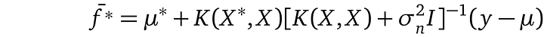
State of the art
Bayesian optimization (BO) is a state-of-the-art optimization method for expensive systems such as hyperparameter tuning for machine learning models.
BO uses a surrogate model to represent the system, such as Gaussian Processes.
Gaussian Process Regression has scaling issues with the number of observations (n).
n x n matrix

Slide 20
State of the art
Bayesian optimization (BO) is a state-of-the-art optimization method for expensive functions (e.g. hyperparameter tuning for machine learning models).
BO uses a surrogate model to represent the function, such as Gaussian Processes.
Many improvements to Gaussian Processes have been suggested:
Additive kernels (Duvenaud 2011, Lu 2022)
Constraint modeling (Gardner 2014)
Input prior specification (Souza 2021)
Parallel BO (Wang 2020, Li 2022)
Scalable approximations (Wang 2019)
…

Slide 21
Research Methodology
Literature review
Improvements for Bayesian Optimization methodology
Analysis
Structural properties of simulation models
Design & development
Adapting improved techniques to our simulation models
Evaluation
Tests in simulation models used in published biomedical research
Dissemination

Slide 22
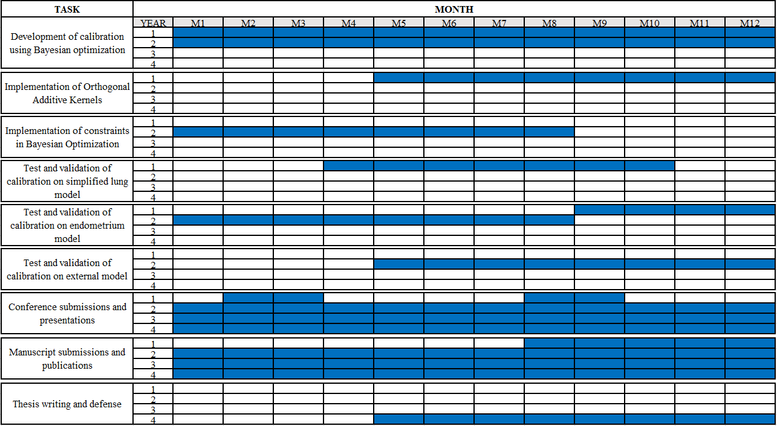
Work plan

Slide 23
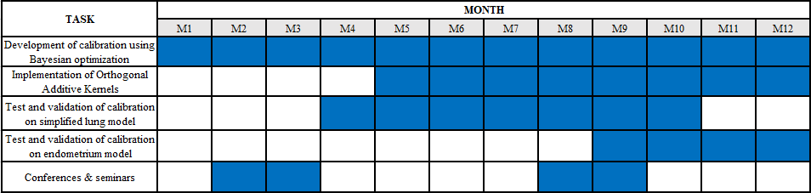
Detailed work plan for the current academic course (1ST year)

Slide 24
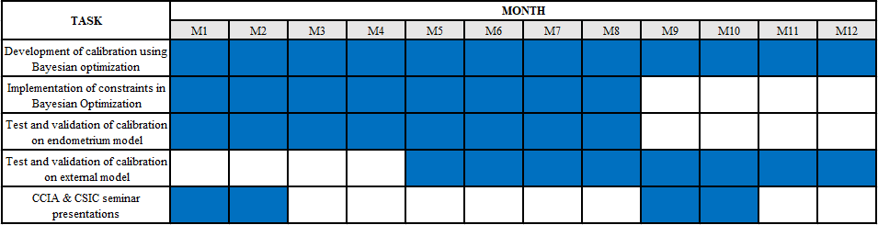
Detailed work plan for the current academic course (2ND year)

Slide 25
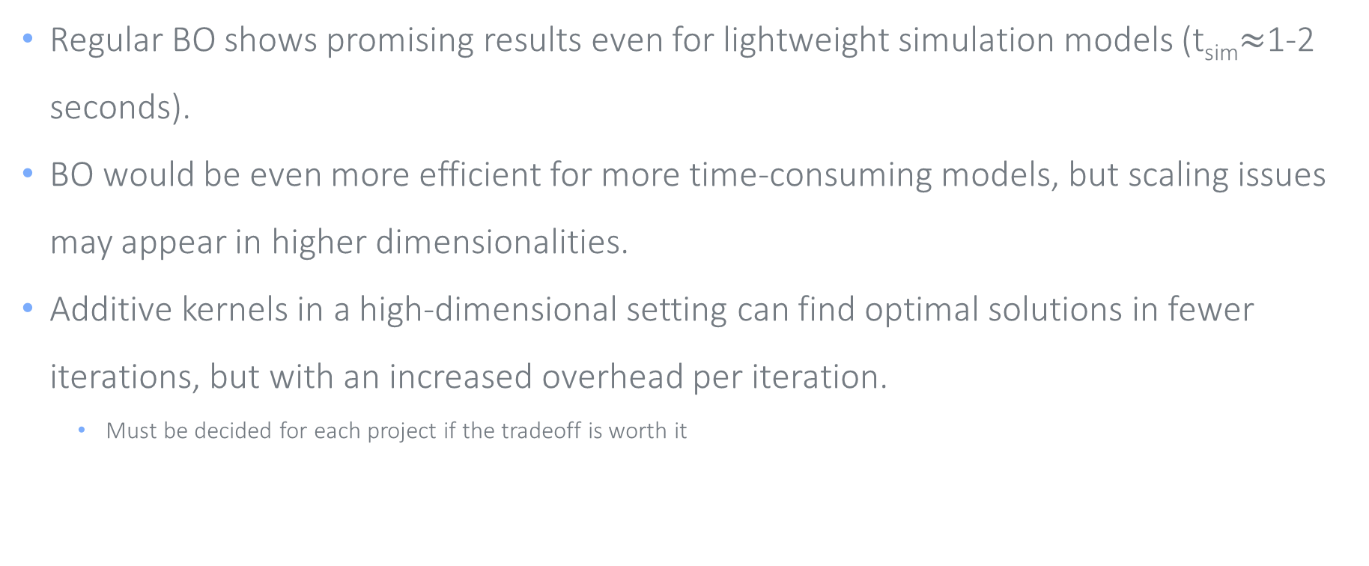
PRELIMINARY RESULTS
Regular BO shows promising results even for lightweight simulation models (t_{sim}$≈$1-2 seconds).
BO would be even more efficient for more time-consuming models, but scaling issues may appear in higher dimensionalities.
Additive kernels in a high-dimensional setting can find optimal solutions in fewer iterations, but with an increased overhead per iteration.
Must be decided for each project if the tradeoff is worth it

Slide 26
Publications and presentations
Gómez-Guillén D, Montoliu S, Arcos JL, Cerquides J, Diaz M. Bayesian optimization for calibration of simulation models to perform cost-effectiveness analysis. PhD Day 2022. IDIBELL. Spain. [Poster session]
Gómez-Guillén D, Diaz M, Arcos JL, Cerquides J. Bayesian optimization with additive kernels for the calibration of simulation models to perform cost-effectiveness analysis. CCIA 2023 [Accepted]

Slide 27
Conclusions
Cost-effectiveness analysis is a fundamental tool in biomedical research.
Simulation models need to be calibrated to ensure coherent results.
Calibration can be very time consuming and produce incoherent parameters.
Bayesian Optimization can help calibrate simulation models more efficiently and obtain better parameters.

